Slide 1

PANIMALAR ENGINEERING COLLEGE
AN AUTONOMOUS INSTITUTION
DEPARTMENT OF INFORMATION TECHNOLOGY

Slide 2
FOOD SUGGESTING CHAT BOT
TEAM MEMBERS
1.V.SUNIL KUMAR (2020PECIT210)
2.S.RONAL REGAN (2020PECIT198)
3.R.RANJITH KUMAR (2020PECIT195)

Slide 3
ABSTRACT
Now a days people are using the food delivery app on huge scale and day by day the demand for these apps are increasing on huge scale. The ultimate aim of this chat bot is to take care of the customers health too. Here we use the artificial intelligence and data science to work on the BMI of the customer to predict the perfect food for them. Apart from this it too takes care of the customer’s diet if so he/she suffers from the long term diseases like Diabetics, Blood pressure and other medical conditions too with the help of the BMI. So by following the healthy food habits, a healthy lifestyle can be maintained.
Index Terms- Chat-bot, BMI detection,Artificial Intelligence, Data Science

Slide 4
LITERATURE SURVEY
Diaa Salama AbdElminaam and noha ElMasry [6]On July 03, 2021 the National University of Singapore published a chat bot for the Fake CV detection. Here the bot will detect and report the CV generated using the dataset trained. This bot will be very much useful for HR team to detect the fake CV when there is huge number of CV’s to be screened.
Previously, On June 17, 2021 [7] Sai Sharath and Banafsheh, the University of Calif Santa Barbara published a chat-bot to answer the General Knowledge questions asked to bot. Here the bot is trained in with the pre-trained BERT Language called topic entity. The question q, candidate entity e and the candidate answer entities-set are sent to the QA model. Using this the answer set will be selected as the final answer.

Slide 5
LITERATURE SURVEY
Anna Hjalmarsson and Marten Bjorkma, in 2019, a sentiment -based chat bot [8] was developed in python for automatic twitter replies. Here the bot functioning is based on the previous replies made in the same kind of situation is collected as a data set and the bot prediction of emotion is made.
Anupam Mondal and Monalisa Dey, [9]An automated conversation system for the educational domain was created during late 2018. In this application they collected the data-set of around 1500 questions and then processed it and response selection was made after which the chat-bot was built.
During 15th September 2018, [10]a chat-bot was created to maintain the college management system using Artificial Intelligence and Natural Language processing.

Slide 6
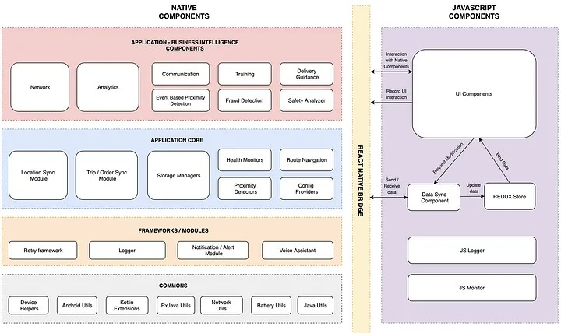
EXISTING SYSTEM

Slide 7
FEATURES
•Our bot is focused on food.
•It has features to suggest food based on your taste, search recipes based on your available ingredients or order food.
•We have also added a feature where you can ask our bot about the nutrients or vitamins present in any food item.
•You can also get a diet plan from our bot based on your height and weight(BMI).
•You can also search top restaurants near to you.

Slide 8
TARGET AUDIENCE
•Food is a necessity for each and everyone.
•Our bot is aimed at delivering every features regarding with food.
•So, our bot can be used by everyone.
•Our bot can be integrated to any food delivery service website or app.

Slide 9
PROPOSED SYSTEM
Here we are proposing a new chat-bot named as DIONYSUS which performs various functions like prescribing the customers with their food of choice, making the orders for their food, searching for the near hotels, checking for the recipe with the ingredients, displaying some raw facts, searching by cuisine and direct person-to-person message. Let us consider the entire operation performed by the DIONYSUS through the flow-chart.

Slide 10
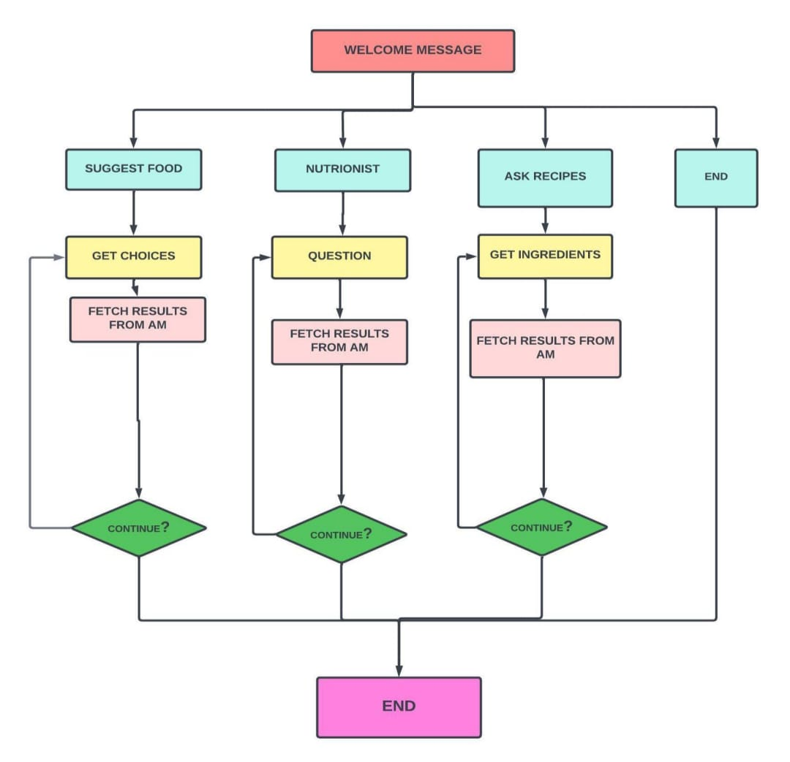

Slide 11
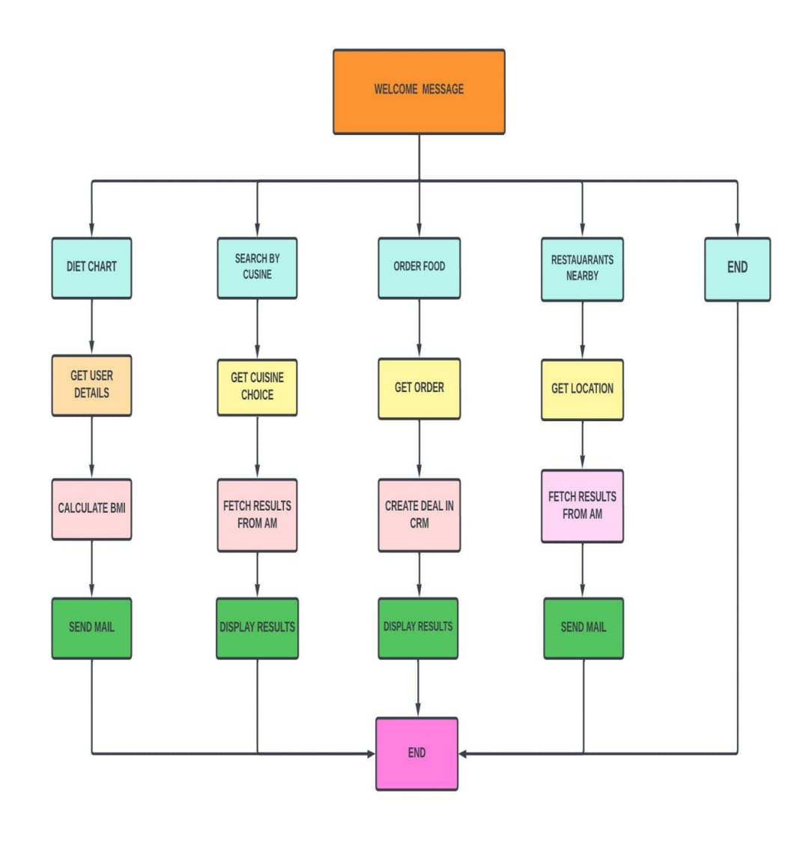

Slide 12
HARDWARE REQUIREMENTS

Slide 13
Intel i3 processor
4GB RAM
100GB ROM

Slide 14
SOFTWARE
REQUIREMENTS

Slide 15





DELUGE

Slide 16
USER SCENARIO:
Food Suggester:
Users can request the bot to suggest them food items based on their own taste.
Dionysus the Chef:
Users can ask our bot food recipes based on the ingredients they have available.
They can also ask about the nutrient contents in a specific dish.

Slide 17
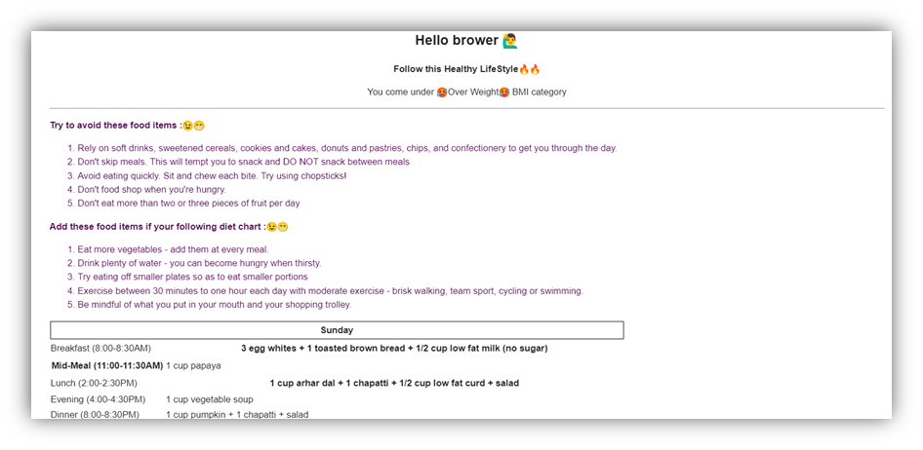
USER SCENARIO:
•Our bot suggests the user to a diet chart based on their height and weight(BMI).
Diet Chart:

Slide 18
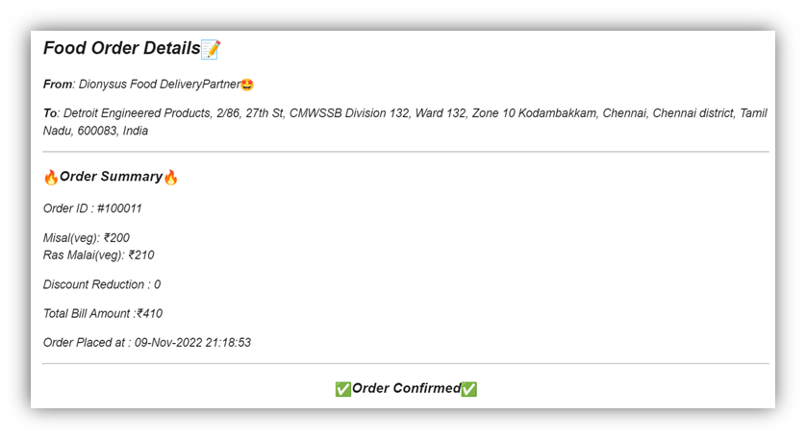
USER SCENARIO:
Order Food:
•Users can even order food with our bot.
•A confirmation mail is sent to the mail-id that they have provided with unique orderID.

Slide 19
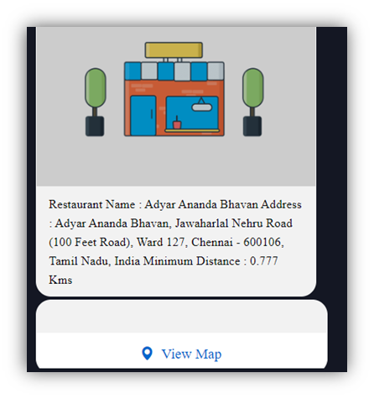
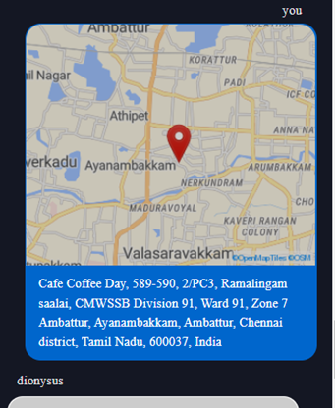
USER SCENARIO:
Restaurant finder:
•This feature allows the user to search restaurants near them.

Slide 20
OUTPUT
SCREENSHOTS

Slide 21
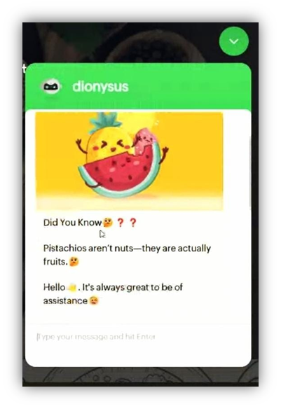
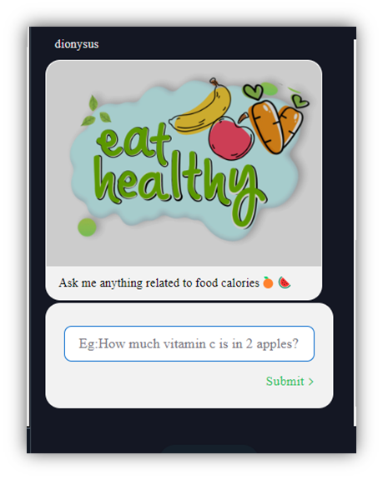
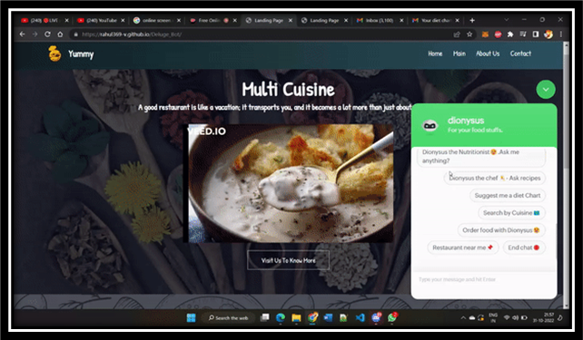

Slide 22
DIONYSUS COMPONENTS
ZOHO Sheets as Database
Spoonacular API connection
ZOHO CRM Connection
Send Email
Input & Display widgets
GEOapify
APIConnection

Slide 23
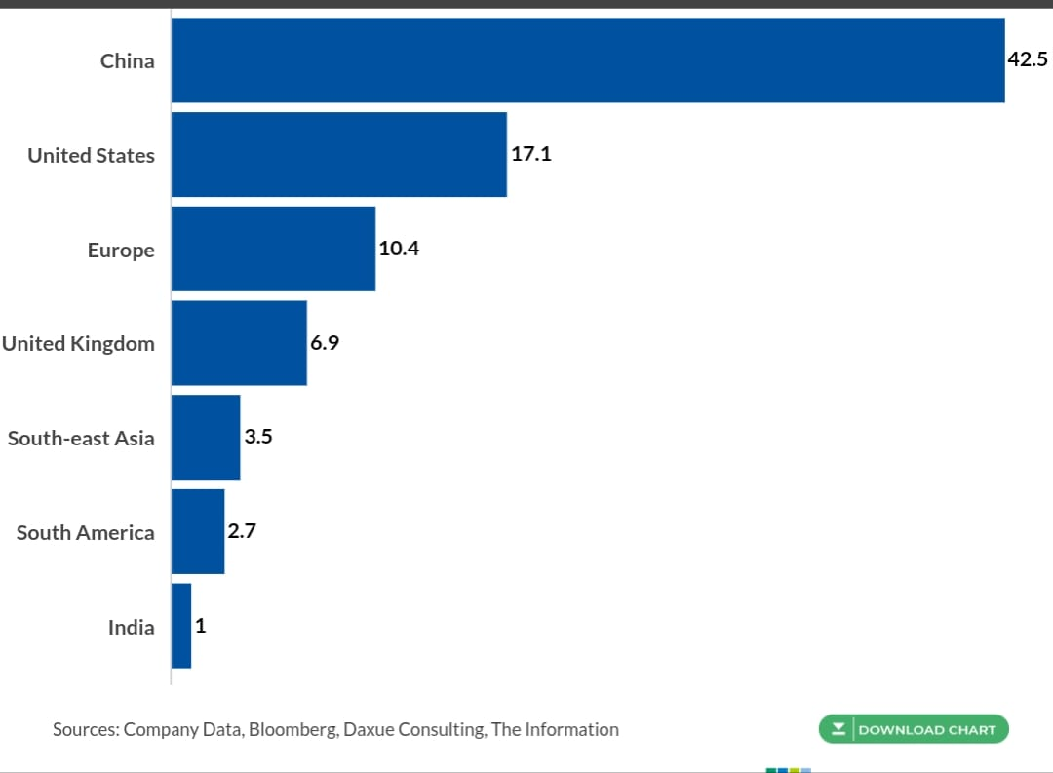
ANALYTICS
Food delivery revenue by country in $ billions by 2021

Slide 24
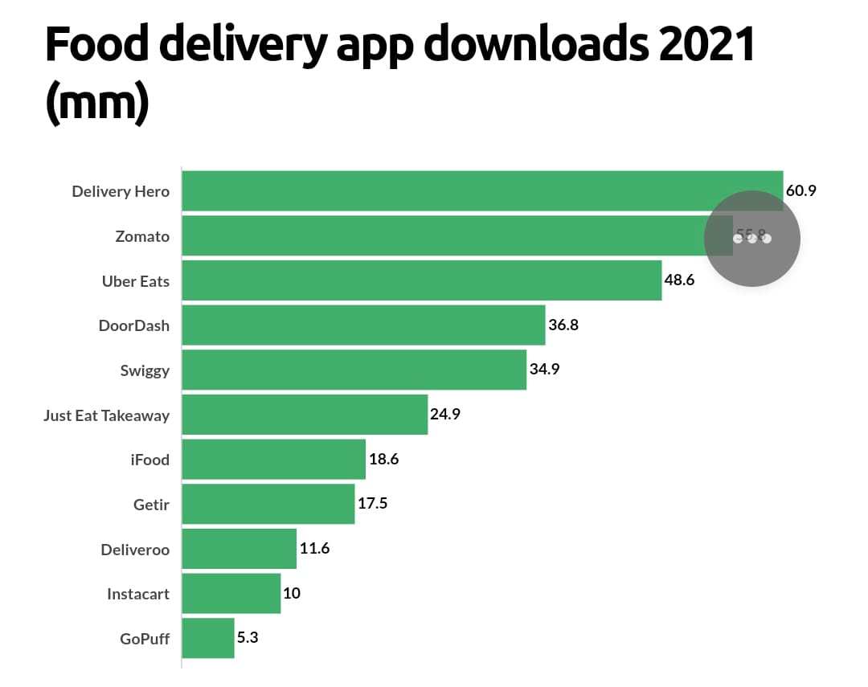
ANALYTICS

Slide 25
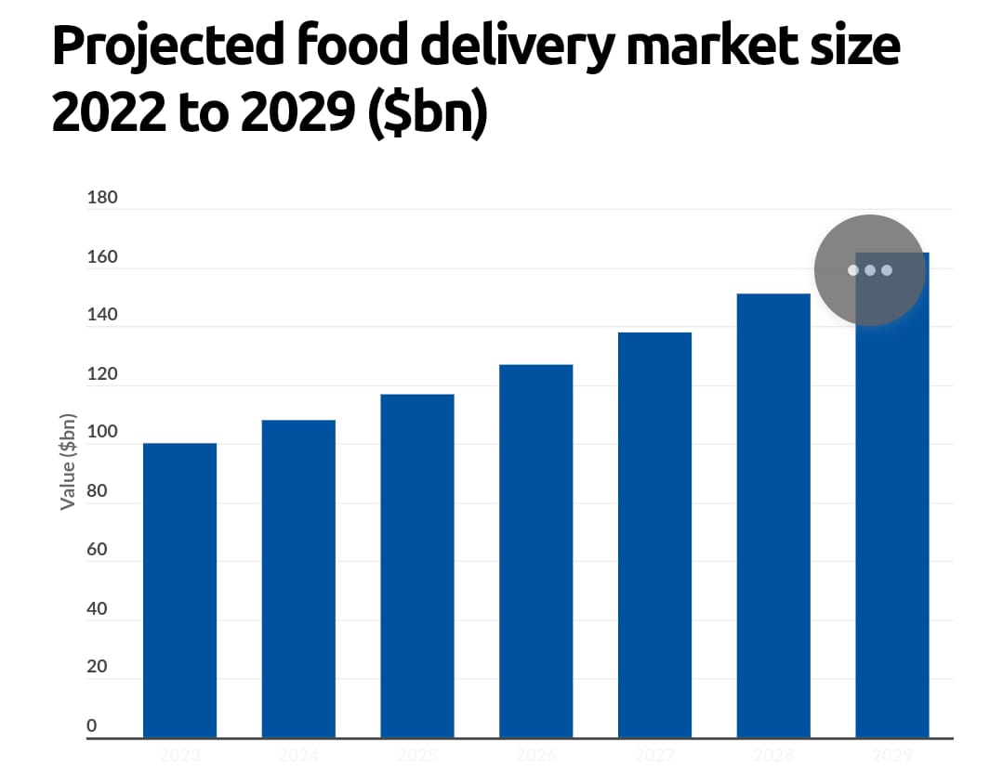
ANALYTICS

Slide 26
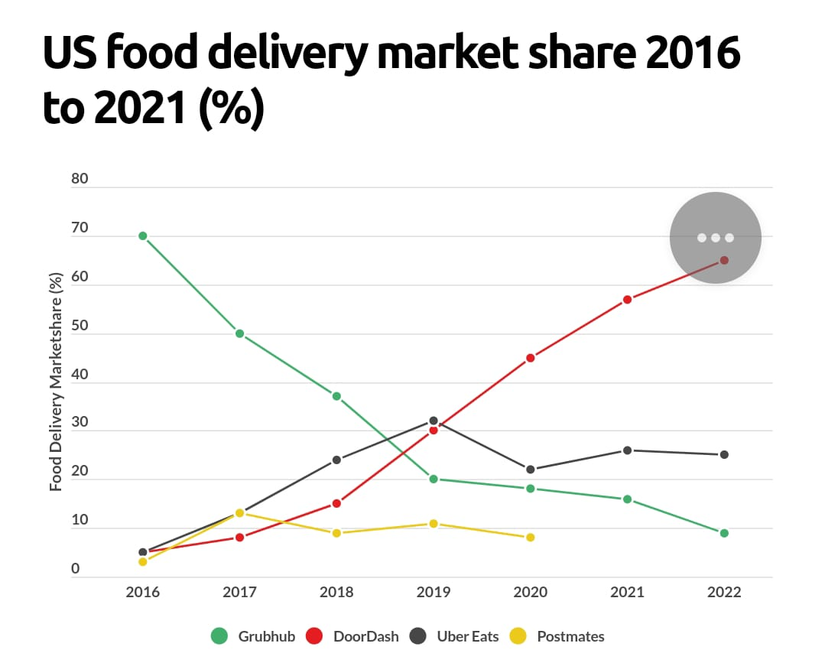
ANALYTICS

Slide 27
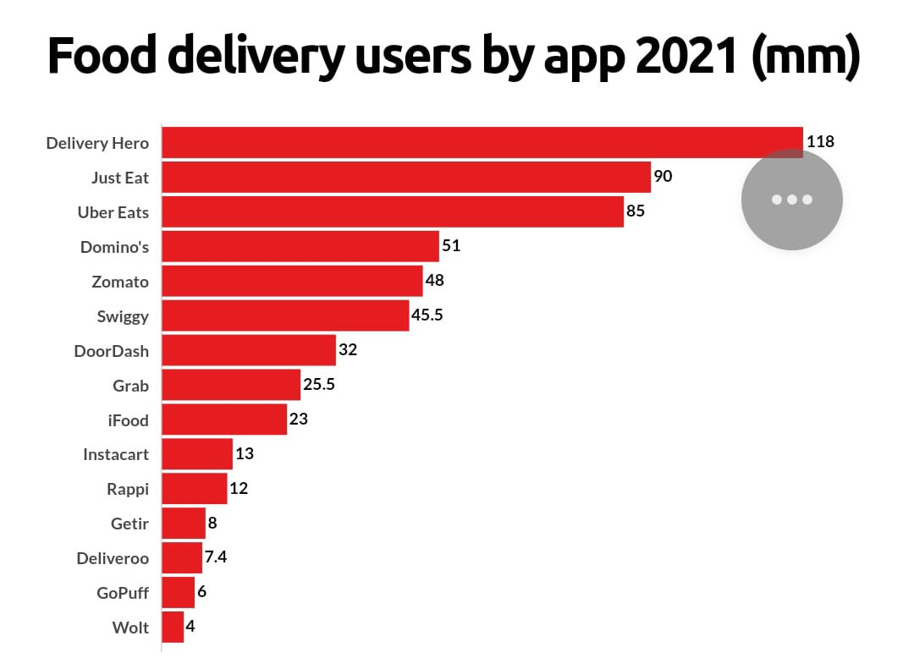
ANALYTICS

Slide 28
QUESTIONS?

Slide 29
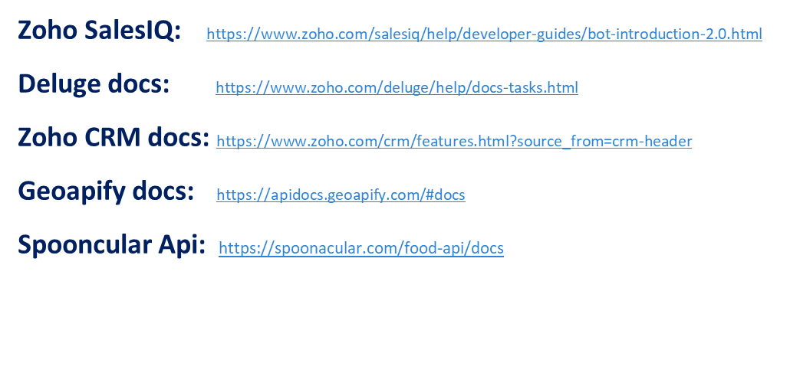
REFERENCES

Slide 30
THANKS!

